Slide 1
Access to Information in your new country – Cyprus
Notes:
This resource aims to help migrants and refugees with their quest to access important information in their new communities. It discusses the importance of accessing information from the very beginning of someones’ arrival to a new country and throughout their integration process. It then lists and explains different sources where migrants and refugees can find more information in Cyprus.

Slide 2
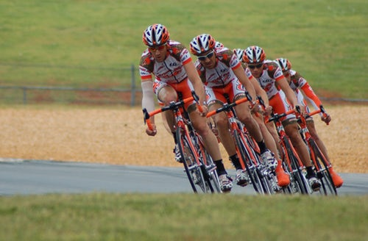
Introducing the issue
Notes:
Everyone needs information on the law, employment, education, health, housing, sports and culture in the place where they live, regardless of whether they are migrants or locals. People constantly surf the internet to find the latest information, either for employment, higher education or in order to find out about latest athletic opportunities or cultural events.
Moving to a new country as a migrant worker, student or refugee always has challenges. You are in a new environment, completely unknown to you, most probably without a strong support system and local network around you. Whether you had an opportunity to search for information before your journey, or not, you will still require to find out a lot of new information in the new country in order to settle in. Even if you have settled in, seeking information about the different aspects of your daily life will continue to be important for you for a long period of time.

Slide 3
Lost or Confused?
Notes:
It is very important for migrants and refugees to know the various official procedures they need to follow once they arrive at a new country. Having access to these information, and to a simple guide that explains the various procedures, their rights and responsibilities can influence very positively their settling in. Lack of information on the other hand causes a lot of additional stress and creates difficulties for them.

Slide 4
Rights and responsibilities
Governmental procedures
Employment
Housing
Children’s Education
Health
Language Learning
Local culture and society
Notes:
According to research that was done in Cyprus with migrants and refugees, the most important areas where they need to have more information are:
Their rights and responsibilities
Governmental procedures in each department
Employment
Housing
Children’s Education
Health
Language Learning
Local culture and society

Slide 5
Public services
Non-governmental organisations (NGOs)
Specialised websites
Local authorities
Migrant led organisations
Volunteers’ Groups
Where can you find these information?
Notes:
Being in a new country, your first question is, who can provide you with this kind of information?
Usually, the first persons you turn to are people of your community. However, they may not always have all the answers to your specific situation, and even if they do, they may not always be able to help you.
The most important organisations that provide these information are those that directly offer the services or organisations that assist migrants and refugees. These can be:
Public services
Non-governmental organisations
Specialised websites that offer information on a specific issue.
Local authorities
Migrant led organisations
Volunteers’ Groups

Slide 6
Getting Information
Notes:
There are a few ways you can find out information from these organisations.
The best way to get initial information is to check the websites and facebook pages of these organisations for any information they have as well as other relevant websites. This will also help you get a broad understanding on the issue you are interested in.
If they do not have enough information on their website, or if you need more details you can then contact them. Depending on the kind of organisation it may be better for you to first call and try to get the information you need and then visit their offices.
If you see that you need assistance with understanding the governmental procedures and your rights, if you face difficulties, or if you cannot communicate with the public authorities at all due to language obstacles you can contact the non-governmental organisations (NGOs) and ask for their help.

Slide 7
Websites
www.mihub.eu/en/info/info-by-topic
help.unhcr.org/cyprus/
www.cyprus-guide.org/en
www.helprefugeeswork.org → Employment opportunities for recognised refugees and persons with subsidiary protection
www.support-refugees.eu → Interactive map where you can find services & other facilities in your area
goo.gl/QPeMLH → Google map of locations in Cyprus where they are assisting refugees (created by volunteers)
General information on all aspects of life for refugees and migrants in Cyprus
Notes:
Are you wondering which are these organisations and websites?
The following slides will provide an overview of the most relevant websites, services and organisations that work in the field of migration and international protection in Cyprus or which can give you more information about your life in Cyprus.
Websites providing comrehensive information for migrants or refugees on different aspects of life in Cyprus, including their rights and how to access public services include:
The website of the Migrant Information Centres
help.unhcr.org/cyprus/ by the United Nations High Commissioner for Refugees (UNHCR) office in Cyprus
cyprus-guide.org/en/ - by INNOVADE and CARDET.
The website www.helprefugeeswork.org, a new employment website providing a platform for recognised refugees and person with subsidiary protection in Cyprus to link with employers who have open job positions.
The website www.support-refugees.eu will provide an interactive map where you can find offices and other facilities close to your place of living.
A group of volunteers has also collected on a google map all known locations of organisations and volunteers that offer assistance to refugees in Cyprus.

Slide 8
Governmental Services
Civil Registry and Migration Department
Asylum Service
District Immigration Police Offices
Social Welfare Services
Office of Combating Trafficking in Human Beings of the Cyprus Police.
District Labour Offices
Ministry of Health
Ministry of Education
Links to all the services are provided at the end of this resource.
Notes:
The main governmental department responsible for issues of migration, is the Civil Registry and Migration Department of the Ministry of Interior.
For asylum seekers and the system of asylum the relevant authorities are the Asylum Service of the Ministry of Interior which examines all asylum applications and the District Immigration Police Offices where someone can apply for asylum.
Issues related to welfare for asylum seekers, refugees and persons with international protection are dealt with by the Social Welfare Services.
To report a case of human trafficking, a victim or representative can contact the Office of Combating Trafficking in Human Beings of the Cyprus Police.
In the case that you are legally allowed to seek employment (for example if you are a recognised refugee or person with international protection, or if you applied for asylum more than 6 months ago), you can register with the District Labour Offices.
Finally, issues of health care are dealt with by the Ministry of Health, while children’s education and publicly offered language courses fall under the Ministry of Education.
Links for all these services are provided at the end of this resource. Contact information for most of these services can also be found at: help.unhcr.org/cyprus/

Slide 9
Migrant Information Centres (Mihub)
www.mihub.eu/en
Caritas Cyprus
www.caritascyprus.org
KISA – Action for Equality, Support, Antirasism
www.kisa.org.cy
Cyprus Red Cross Society
www.redcross.org.cy
Cyprus Refugee Council
www.cyrefugeecouncil.org
Hope For Children CRC Policy Center
www.uncrcpc.org
NGOs working with migrants & refugees
Notes:
In addition to the governmental services there are several non-governmental organisations that work to assist migrants and refugees to access their rights and to be able to settle in Cyprus. The most important organisation that offer services to migrants and refugees are listed below. These organisations can give you advice on all aspects of your integration in Cyprus:
MyHUB – Migrant Information Centres (operating in all the cities).
Caritas Cyprus, based in Nicosia, with operations also in Larnaca and Paphos.
KISA – Action for Equality, Support, Antirasism, based in Nicosia.
Cyprus Red Cross Society, operating in all cities.
Cyprus Refugee Council, based in Nicosia, which focuses on asylum seekers, refugees, persons with subsidiary protection and victims of torture.
Hope for Children CRC Policy Center, based in Nicosia but operating shelters for unaccompanied minors in different cities. Hope for Children’s work is focused on children’s rights, irrespective of their migration status.

Slide 10
Volunteer’s Groups
Notes:
There are also some volunteer’s groups that provide a lot of support especially to vulnerable migrants and refugees. They help them in many different ways. For example, they collect essential daily items and distribute them to vulnerable migrants and refugees, help them find housing and furnitures for their new houses, organise short trainings and social excursions or events, accompany them at the various governmental offices, inform them about their rights and help them navigate the various procedures. Some of these groups include:
Kofinou We Care – a volunteers’ group operating mainly at the Kofinou Refugee Reception and Accommodation Centre
“OASIS”, based in Larnaca
“The Learning Refuge” in Paphos and
AGAPI in Limassol.
You can also reach out to other organisation that work with a specific community to which you belong. For example, we have the following organisations:
The Association of Recognised Refugees in Cyprus.
AcceptCy; which promotes the rights of all persons that are Lesbians, Gay, Bisexual, Transexual and Intersex (LGBTI)

Slide 11
Independent Supervisory Bodies
Ombudsman - Commissioner for Administration and Protection of Human Rights –
www.ombudsman.gov.cy
Commissioner for Children’s Rights –
www.childcom.org.cy
Independent Authority for the Investigation of Allegations and Complaints Against the Police
www.iaiacap.gov.cy
Notes:
Independent Supervisory Bodies are independent institutions, which means they are not part of the government or the public services and they are not affiliated to any public or private organisation. These institutions are responsible to ensure the protection of citizens rights and human rights in general. Their role is to investigate and report instances where there has been maltreatment or maladministration on behalf of public authorities in the application of the law. If you believe you have been a victim of mal-administration and mal-treatment you have the right to file a complain at one of theses bodies.
The most important Independent Supervisory Body is the Ombudsman, that is the Commissioner for Administration and Protection of Human Rights - www.ombudsman.gov.cy
You may contact the Ombudsman if you believe that:
A public agency or a public officer handled a case of yours in an unjust manner or in contrast to the laws or to the principles of administrative law or has unjustifiably delayed to respond to your request.
A public or private body has mistreated you because of your gender, race, ethnicity, the community you belong to, your language, color, age, disability, sexual orientation, religion, political or other beliefs.
Any of your rights is violated (e.g. access to employment, education, health) due to disability
Other Independent Supervisory Bodies are:
The Commissioner for Children’s Rights and
The Independent Authority for the Investigation of Allegations and Complaints Against the Police

Slide 12
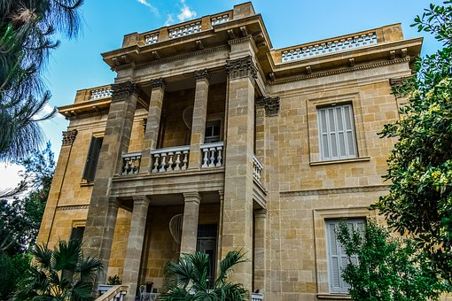
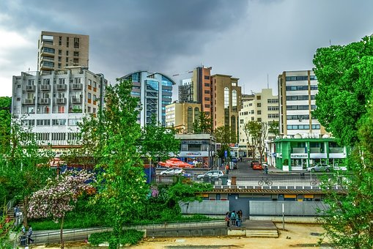
Local Authorities
Notes:
Local Authorities and Municipalities may also be very useful for your integration to the new community. Several Municipalities organise integration related activities, from Greek language courses and child-care services for children under 5 to multicultural festivals. It is difficult to list here an exhaustive list of all the Municipalities. We encourage you to reach out to the Municipality in the district where you stay and in the neighbouring districts and ask them what integration and intercultural activities they offer. They may also be able to advice you on what other services exist in your area which can be useful for you.

Slide 13
Language Courses
Notes:
Knowing the local language is perhaps one of the most important ways to help you integrate in your new society and make your daily life more comfortable. Unfortunately in Cyprus, Greek language courses are not widely available nor enough for everyone who is newly arrived on the island.
Language courses are mainly offered by:
the Ministry of Education through the Adult Education Centres and the State Institutes of Further Education
Higher education institutions such as the KES College
Language based projects
NGOs and civil society organisations and
Some Municipalities.
The last slide of this resource provides a list with the websites of organisations and projects that currently offer greek language courses.

Slide 14
Other civil society organisations and networks
CARDET (www.cardet.org )
Synthesis (www.synthesis-center.org )
Aequitas (www.aequitas-humanrights.org )
NGO Support Centre (www.ngo-sc.org )
Cyprus Aware (www.cyprusaware.eu )
Pan Cyprian Voluntary Organisations http://www.volunteerism-cc.org.cy/pan_cyprian_voluntary_organisations
All NGOs in Cyprus https://www.ngosincyprus.org/All-NGOs

Slide 15
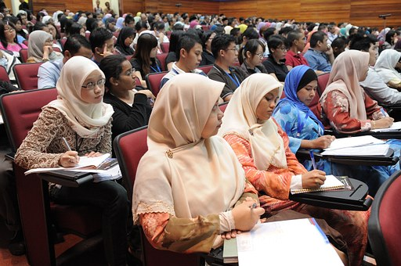
Stay informed
Follow them on social media
Register on their newsletters
Attend public events
Join community & volunteers’ groups
Notes:
Finally, what do you need to do to remain updated on latest information or events that may be of interest to you?
Here are some suggestions:
Follow their social media accounts and register on their newsletters
Attend the public events they organise
Attend specialised events where they discuss these issues
Get more involved with your community, voluntary and community groups
Follow other well informed websites that promote cultural events.

Slide 16
Practice
Vanessa
26 years old
Staying with a friend
2 years in the country
Left abusive employer
Looking for a new job
Afraid to be sent back
Notes:
Vanessa is 26 years old. She is staying temporarily with your friend. She has been in the country for 2 years working with an abusive employer. She decided to quit her job but she needs to continue working here in order to support her family back home. She doesn’t know what to do now and she is afraid she may be sent back home since she left her employer. She needs more information and assistance to know her rights and what does she need to do next.

Slide 17
Practice
Discuss in a small group & plan her next steps
Consider things like:
What are the most important information that she immediately needs?
What other needs will she have in the next few months?
Which organisations or services can help her?
What are the first steps she should take?
What can be the role of the various types of organisations?
Notes:
Discuss in a small group and make a plan on what are the next steps she should take. Consider things like:
What are the most important information that she immediately needs?
What other needs will she have in the next few months?
Which organisations or services can help her?
What are the first steps she should take?
What can be the role of the various types of organisations: such as a) public authorities b) NGOs c)volunteer and community groups d)local authorities e) independent supervisory bodies f) any other?

Slide 18
Governmental Services
Civil Registry and Migration Department
http://www.moi.gov.cy/moi/crmd/crmd.nsf/index_en/index_en?OpenDocument
Asylum Service http://www.moi.gov.cy/moi/asylum/asylumservice.nsf/
District Immigration Police Offices
http://www.police.gov.cy/police/police.nsf/dmldept15_en/dmldept15_en?OpenDocument
Social Welfare Services
http://www.mlsi.gov.cy/mlsi/sws/sws.nsf/dmlcontactus_en/dmlcontactus_en?OpenDocument
Office of Combating Trafficking in Human Beings of the Cyprus Police.
http://www.police.gov.cy/police/police.nsf/All/B62C14B4889EC3A3C22578A900271B28?OpenDocument
District Labour Offices http://www.mlsi.gov.cy/mlsi/dl/dl.nsf/All/CDC4767871307868C22580E50031DD2C?OpenDocument
Ministry of Health www.moh.gov.cy
Ministry of Education http://www.moec.gov.cy/en/index.html

Slide 19
Language Courses
iLearnGreek – www.ilearngreek.eu
GeiaXara – www.geiaxara.eu
State Institutes of Further Education, Ministry of Education - http://www.moec.gov.cy/en/state_institutes.html
Adult Education Centres (epimorfotika), Ministry of Education - http://www.moec.gov.cy/epimorfotika/en/index.html
The Learning Refuge – CARITAS Pafos - https://www.facebook.com/learningrefuge/
CARITAS Cyprus Migrant Centres – www.caritascyprus.org
OASIS – www.facebook.com/oasislarnaca
Migrant Information Centres (MiHub) – www.mihub.eu
Synthesis Centre for Research and Education – www.synthesis-center.org
University of Cyprus – School of Modern Greek - http://www.ucy.ac.cy/mogr/en/courses

Slide 20
Thanks!

