Slide 1
Advocacy and Campaigning

Slide 2
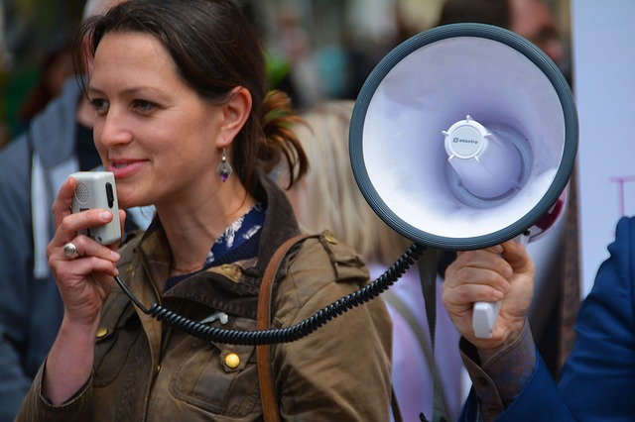
Having a Voice
Notes:
In this lecture, you will be introduced to an approach to support you if you are interested in implementing an event in your community. With a structured approach, you will learn what it needs to bring people together to celebrate, exchange their experiences or help each other with certain issues communities have to face.

Slide 3
What are Advocacy and Campaigning?

Slide 4
How do I plan for Advocacy and Campaigning?
Research and understand the issue
Identify and understand your opponents
Establish goals and dentify tools to assist in your campaign
Find allies for your cause

Slide 5
Research and understand the issue

Slide 6
Find allies for your cause

Slide 7
Identify and understand your opponents

Slide 8
Establish goals and identify tools to assist in your campaign

Slide 9
Get Inspired – Media Campaigns
https://www.youtube.com/watch?v=-LDn32PzN-w
https://www.youtube.com/watch?v=JyL58vlbvgw
https://www.youtube.com/watch?v=KOKUT8mDClc
https://www.youtube.com/watch?v=By_BHbskg_E

Slide 10
Planning your Campaign

Slide 11
Thanks!
All photographs courtesy of Pixabay.com
This project has been funded with support from the European Commission.
This document reflects the views only of the author and the Commission cannot be
held responsible for any use which might be made of the information contained herein.
Project Number: 2017-1-FR01-KA204-037126

