Slide 1
EU Institutions

Slide 2
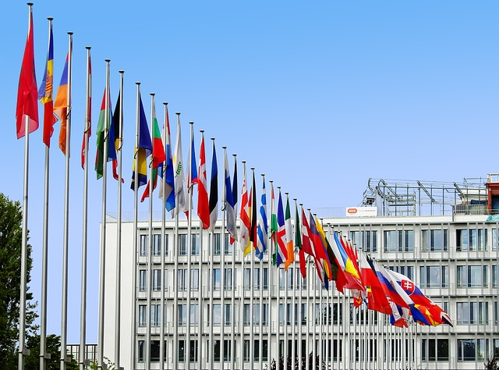
What is the European Union

Slide 3
The 5 main EU Institutions
The European Parliament
The Court of Justice
The Council of the European Union
The Court of Auditors
The European Commission

Slide 4
The European Parliament
Responsibilities:
Legislation - This power is shared with the Council of the European Union.
Finance – The supervision of EU spending. This responsibility is also shared with the Council of the European Union.
Democratic supervision - all EU Community activities are supervised.
The European Parliament monitors negotiations with countries that wish to join the EU and has the power to approve or veto their membership.

Slide 5
The council of the European Union
The Council of the European Union is the main decision making body in the EU.
It shares legislative power with the European Parliament adopting proposals submitted by the European Commission.
It shares responsibility for EU spending with the European Parliament.
There are 28 members - one from each EU state
Each member state holds the presidency on a 6 month rotating basis.

Slide 6
The European Commission
The Commission initiates new legislation by making proposals and implementing decisions made by the European Parliament and the Council of the European Union.
It has responsibility, with the Court of Justice, to ensure that EU legislation is applied by member countries.
It represents the EU internationally, negotiating trade agreements with non-EU countries and working with international bodies on issues such as humanitarian aid.

Slide 7
The Court of Justice
The European Court of Justice (ECJ) ensures that European law is interpreted and applied in each member state.
It comprises of 28 judges, one from each member state.
There are also 8 Advocate Generals who assist the ECJ in making decisions.
Judges and Advocate Generals must be suitably qualified.
Their term lasts 6 years and is renewable.

Slide 8
The Court of Auditors
The European Court of Auditors oversees and audits the budgets and accounts of the European Union Institutions.
The Court is composed of 28 members, one from each state, with experience in auditing public finances.
Candidates are appointed by the Council of the European Union and the European Parliament for a renewable term of 6 years.
Court members elect a president for a term of 3 years.

Slide 9
My Rights as an EU Citizen are…
The right of free movement and residence in the territory of the Member States.
The right to vote and stand for election in European and local elections.
The right to diplomatic protection in third countries.
The right to petition the European Parliament.
The right to bring complaints before the European Ombudsman.
The right to address any of the Union's institutions or bodies in one of the official languages and to receive an answer in the same language.

Slide 10
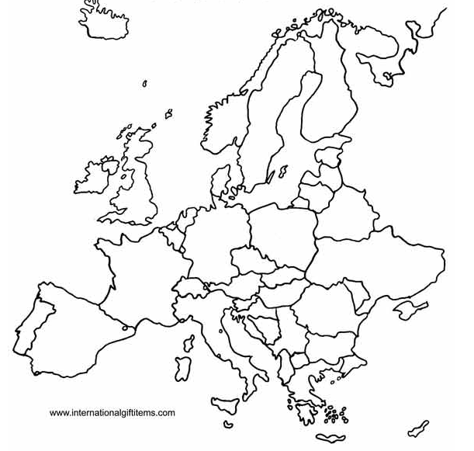
Activity 1 – Fill in the names of the EU Countries

Slide 11
Activity 2 – Connect the facts
The European Commission
It has 28 members with experience in auditing public finances
The Court of Auditors
The current president is Jean-Claude Juncker
The European Parliament
There are 8 Advocate Generals who assist in making decisions
The Court of Justice
Each member state holds the presidency on a 6 month rotating basis
The Council of the European Union
The President is elected every two and a half years

Slide 12
Thanks!
All photos courtesy of Pixabay.com
This project has been funded with support from the European Commission.
This document reflects the views only of the author and the Commission cannot be
held responsible for any use which might be made of the information contained herein.
Project Number: 2017-1-FR01-KA204-037126

