Slide 1
Effective Communication
Notes:
This resource outlines the importance of community cohesion and how it can be strengthened. Joint events promote this cohesion and can provide a platform for disseminating important information and advocating for specific community purposes. In this presentation you will learn how to plan such an event, what to consider and how it can be adequately implemented.

Slide 2
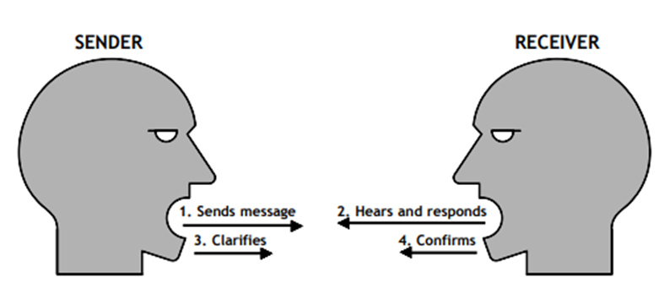
Effective Communication Model

Slide 3
How We Communicate

Slide 4
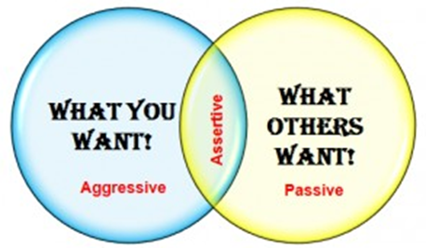
Communication Styles
PASSIVE
AGGRESSIVE
ASSERTIVE

Slide 5
Passive Communicator
Is afraid to speak up
Avoids direct eye contact
Shows little or no expression
Isolates self from groups
Agrees with others despite feelings
Values self less than others
Does not reach goals
You’re okay; I’m not.

Slide 6
Assertive Communicator
Speaks openly
Makes good eye contact
Shows expression to match the message
Participates in groups
Speaks to the point
Values self equal to others
Reaches goals without alienating others
I’m okay; you’re okay.

Slide 7
Aggressive Communicator
Interrupts and ‘talks over’ others
Glares and stares at others
Intimidates others with expressions
Dominates and controls groups
Only considers own feelings
Values self more than others
Reaches goals regardless of impact on others
I’m okay; you’re not.

Slide 8
5 Things Great Communicators Do
They speak with clarity and influence √
They advocate a common vision √
They listen √
They effectively use body language √
They are culturally and politically aware √

Slide 9
Intercultural Communication
A different language is not just a dictionary of words, sounds, and syntax. It is a different way of interpreting reality, refined by the generations that developed the language. Federico Fellini
Notes:
If we stick to Fatima's example, here you see a few activities and plans that she has to consider in order to successfully implement her event.
Her main goal is to establish a child care cycle. In order to promote her idea, she plans, prepares and conducts an event at a room provided by the community centre.
That means that people, who are involved in her project, are people working in the community centre, but also other mothers or friends and family members who could support her, i.e. by assistance or preparation of food for the event.
Fortunately, Fatima already found an appropriate location for her event that she can use for free for approximately two hours. Other activities involve finding a date and time for event that is appropriate for other mothers with small children and for the people from the community centre. She plans to call her good friend to support her with the organisation and to contact other mothers. She also creates a flyer that is available at the centre. Her brother-in-law works at a bakery and is willing to support her with the preparation of snacks. Fatima plans the process of the event, prepares a short presentation with relevant information, creates a group on social media and engages women to sign in a contact list.
She notes resources that she needs: facilities, PC, internet access, paper, presentation, snacks and refreshments. Cold refreshments are provided by the centre, but she has to buy coffee and tea and ingredients for the snacks from her own money.
Fatima is regularly communicating with the people from the community centre, her friend and family members on up-dates, rescheduling or unexpected events.

Slide 10
Intercultural Communication Patterns
Collectivist Cultures
Less focus on verbal interactions
More focus on nonverbal interactions
Often communicate using indirect style
Context of communication is more important
Socially interdependent
Duties and obligations define behaviour
Individualistic Cultures
More focus on verbal interactions
Less focus on nonverbal interactions
Mainly use direct communication style
What is said is more important
Independent
Attitudes and personal needs define behaviour

Slide 11
Low & High Context Cultures
Low Context High Context

Slide 12
Tips for Effective Intercultural Communication
Speak clearly & slowly
Allow time for a response
Avoid jargon or metaphors
Check meanings
Be supportive
Avoid making assumptions
Show respect for others
Ask questions

Slide 13
Effective Communication Worksheet & Games
Understanding Idioms
We often use idioms when we speak. The use of idioms in a language adds colour to it and makes it more interesting for the listeners.
Understanding idioms is an integral part of language fluency and an essential competence for integration into host communities.
Click on the link below to play the idiom game and develop your essential language skills.
www.theidiomgame.eu

Slide 14
Thanks!
All Photographs courtesy of Pixabay.com
This project has been funded with support from the European Commission.
This document reflects the views only of the author and the Commission cannot be
held responsible for any use which might be made of the information contained herein.
Project Number: 2017-1-FR01-KA204-037126

