Slide 1
Event project planning
Notes:
This resource outlines the importance of community cohesion and how it can be strengthened. Joint events promote this cohesion and can provide a platform for disseminating important information and advocating for specific community purposes. In this presentation you will learn how to plan such an event, what to consider and how it can be adequately implemented.

Slide 2
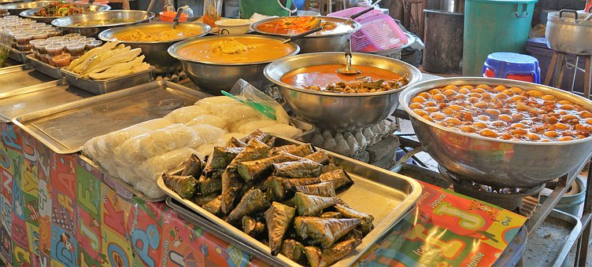
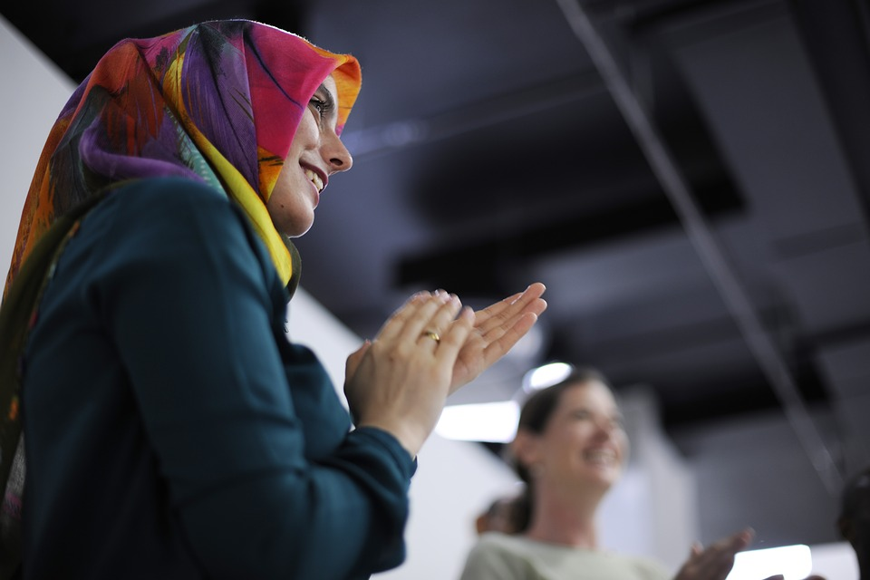
Community events
Notes:
In this lecture, you will be introduced to an approach to support you if you are interested in implementing an event in your community. With a structured approach, you will learn what it needs to bring people together to celebrate, exchange their experiences or help each other with certain issues communities have to face.

Slide 3
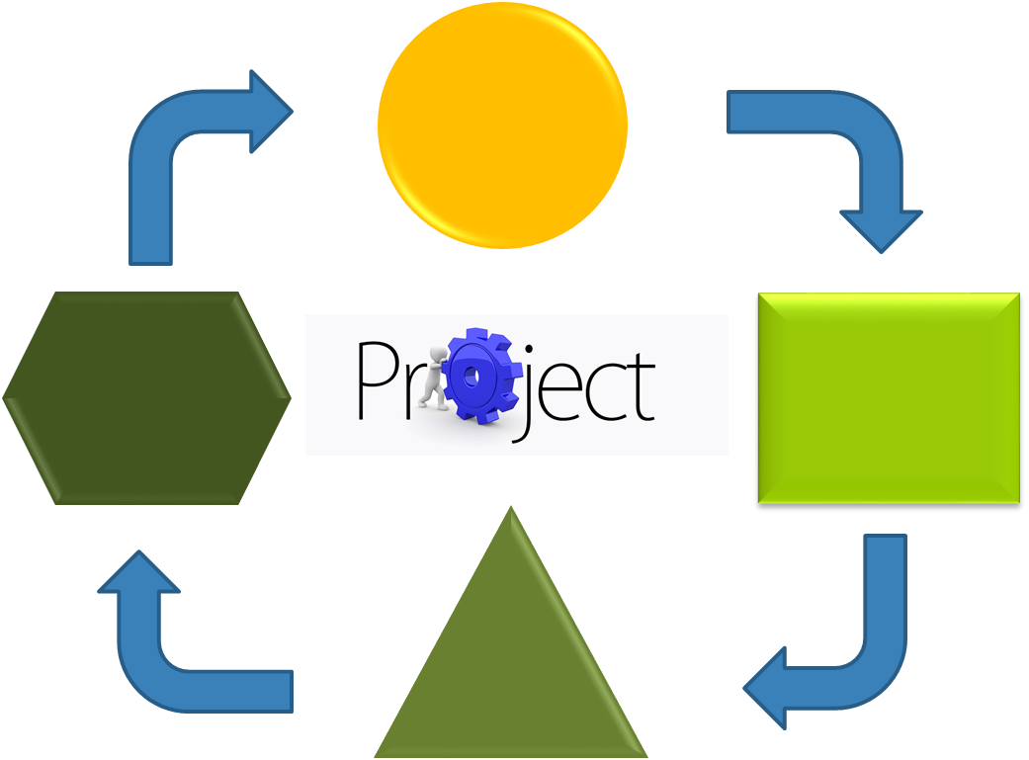
Project method
Notes:
The method used is roughly structured and inspired by methods of project management. More specific, this means that you initially decide on a topic/theme that you would like to discuss in the frame of an event. You will define this topic as a goal that you want to achieve through the event. Further, you define steps to be taken that are needed in achieving the goal. That means that you will structure each phase and consider relevant aspects and actions to be taken.
For introduction, please think of an event that is relevant for your community and that you can also realised. The following questions may help you with this process.
What kind of event could it be? An information event, excursion, networking, leisure or sports activity maybe?
Which topic is interesting/ relevant for your community?
You can also discuss with your neighbour/ a peer or your partner

Slide 4
Phases
Preparation
Realisation
Evaluation
Notes:
In order to support you to realise an event in your community, the “project” is structured in different phases. Each phase includes tasks to be completed. This structure is useful for having an arranged overview of actions. It means that the event is planned in advance taking all aspects of the implementation into consideration.

Slide 5
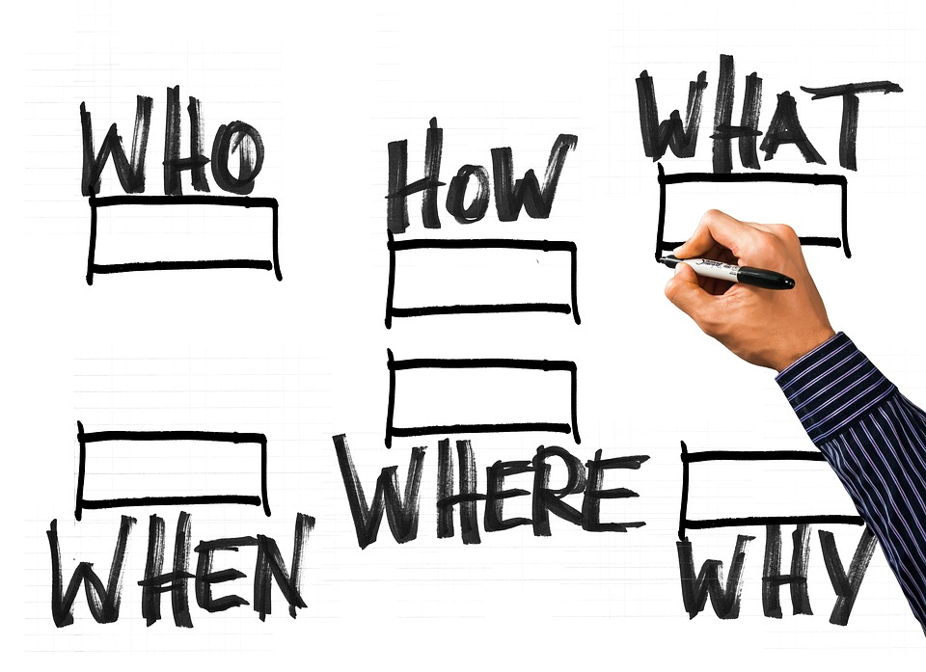
Preparation
Defining goals
Find partners
Define activities
Resources
Communication
Notes:
Good preparation is important because it determines the main aspects to be realised in the following phases. Initially, the main goal of the project needs to be defined. Start with a general goal, and then describe more specific goals for main actions that lead to the overall goal. A clear definition of the goals helps to understand further processes.
In a next step, appropriate “partners” or “peers” have to be found. These are people, who help you with your project, who provide you with resources you need or services you want to make use of. Further, you need to define, who you want to address with your project or who should make use of or benefit from it.
In a next step, you plan which activities you need to conduct. To identify details for each action, ask yourself: Who should do what, why, when and how?
Another important aspect is the identification of resources you will need for the implementation of your project. Make sure to be aware, what kind of resources you have and what you need. Your partners could support you with the provision of resources. Ask yourself:
What do I have?
What can I get (easier) from them?
What else do I need?
Finally, an aspect that is relevant throughout the whole project phases is communication. Communication takes place at different levels and with different actors: participants, environment, partners (organisations, funding), etc. Communicate with all involved and concerned parties as much and effectively as necessary in order to make sure everyone is clear about tasks, responsibilities and to ensure transparency.

Slide 6
Realisation
Planning
Self-evaluation and reflection
Communication
Notes:
The second phase involves the planning of the event in view of the goals’ achievement with the available (planned) resources, planned steps and possibilities of checking and adapting, scheduling of unforeseen events, etc.
Self-evaluation and reflection involves monitoring throughout the whole process. It is useful to question actions and think of their relevance and effectiveness in view of the goals.
And again, communication is a relevant aspect. It will be needed to communicate with all involved as well as with people outside or not yet involved.

Slide 7
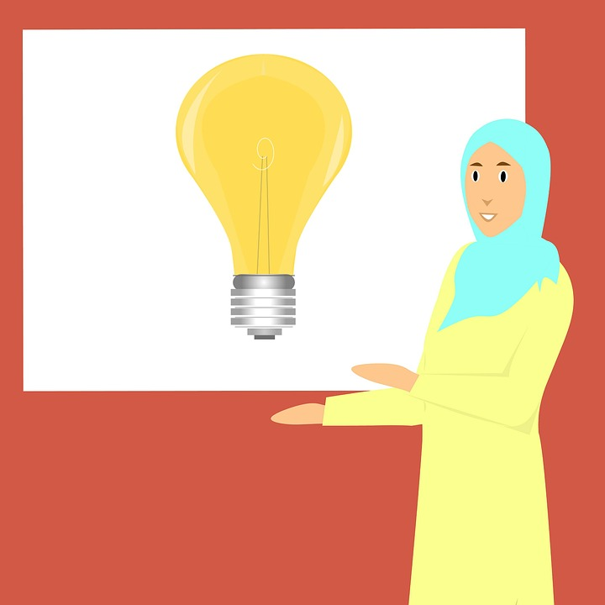
Evaluation
Checking goal achievement
Checking of resources
Communication
Notes:
Checking the achievement of goals is useful to make your success visible. If the goal was not achieved within the planned period of time, this does not necessarily equate to a failure. You can use experiences to reflect actions and to learn from them. Also, it is a good opportunity to exchange views with the people involved.
Checking of resources is useful to view, if you used your resources appropriately, if you can renounce some or if you need more.
As previously mentioned, communication is an important aspect. Include your partners and participants in order to learn from them.

Slide 8
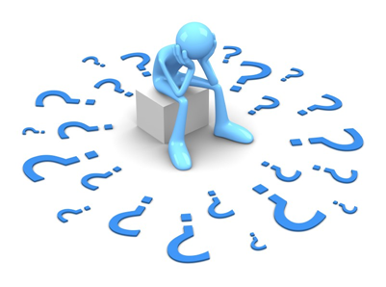
Questions?
Notes:
This short theoretical input should give you an overview of how events can be implemented by applying a structured approach. Are there are any questions so far?
In the second part, there will be a case study and possible activity examples of project planning in order to make the process clearer and better understandable.

Slide 9
Sample Case Study
Fatima
From Syria
Female
28 years old
Married
2 small children
Assistant teacher for middle school
Notes:
Fatima is a young woman, who lived in Syria and came recently with her husband and her two children to Europe. In her hometown, she was working part-time as an assistant teacher at a middle school. In the new country, the process of recognition of her qualification is not yet completed. Also, she feels not confident enough to work as a teacher because of her language skills. She wants to volunteer at an organisation in order to improve her language skills and until her qualification is recognised. In order to have time to find voluntary work, she brings her small children to a community centre in the neighbourhood for a few hours once a week to play. But still, time is not enough. One day, she has an idea. She wants to plan an event at the community centre for young mothers who are also looking for work. Her goal is to establish a child care cycle. That means that each week, one (or more) mother(s) take care of their and the children of other mothers in order to give them the opportunity to search for work or catch up with other things.
Initially, she wants to set up the event for the mothers of the neighbourhood with small children to exchange about employment and work related information and for all participants (mothers and children) to get to know each other. She explains her plan to the head of the community centre who agrees to provide the location and cold refreshments for the event for free. Fatima plans her event and drafts an action plan for each phase.
The event is successful and Fatima manages to engage other mothers participate in the child care cycle.

Slide 10
Examples for event planning
Main goal: to establish a child care cycle
Specific: plan and prepare event, conduct event
Partners: people working in the community centre, other mothers
Activities: find suitable location at the centre, find appropriate date and time for event, contact other mothers for support, create flyers for other mothers to be available at the centre, prepare snacks and refreshments (own resources or support?), structure of event, engage women to sign in a telephone list or group on social media
Resources: facilities, PC, internet access, paper, presentation, snacks and refreshments
Communication: employees from community centre, other mothers, family members
Notes:
If we stick to Fatima's example, here you see a few activities and plans that she has to consider in order to successfully implement her event.
Her main goal is to establish a child care cycle. In order to promote her idea, she plans, prepares and conducts an event at a room provided by the community centre.
That means that people, who are involved in her project, are people working in the community centre, but also other mothers or friends and family members who could support her, i.e. by assistance or preparation of food for the event.
Fortunately, Fatima already found an appropriate location for her event that she can use for free for approximately two hours. Other activities involve finding a date and time for event that is appropriate for other mothers with small children and for the people from the community centre. She plans to call her good friend to support her with the organisation and to contact other mothers. She also creates a flyer that is available at the centre. Her brother-in-law works at a bakery and is willing to support her with the preparation of snacks. Fatima plans the process of the event, prepares a short presentation with relevant information, creates a group on social media and engages women to sign in a contact list.
She notes resources that she needs: facilities, PC, internet access, paper, presentation, snacks and refreshments. Cold refreshments are provided by the centre, but she has to buy coffee and tea and ingredients for the snacks from her own money.
Fatima is regularly communicating with the people from the community centre, her friend and family members on up-dates, rescheduling or unexpected events.

Slide 11
Action plan
Who? Responsible person | What? Activity | Why? Purpose | When? From-to | How? Approach | Comments
Notes:
Starting with the information you received so far, please use this template to plan and structure all the activities needed to implement your event project. Get together with a partner or work individually and try to fill in the template. Try to see it then with someone experienced in event planning to receive feedback. Good luck!

Slide 12
Thanks!
This project has been funded with support from the European Commission.
This document reflects the views only of the author and the Commission cannot be
held responsible for any use which might be made of the information contained herein.
Project Number: 2017-1-FR01-KA204-037126

