Slide 1
Footprints We are Global Eaters

Slide 2
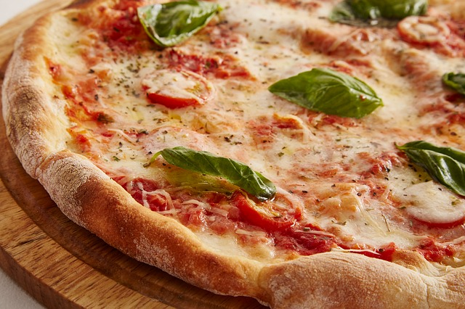
We all have our favorite Italian
Pizza was a street food
eaten by the poor
in Naples around
the 16th Century.
Pizza Margherita was
Created when Queen
Margherita and
her husband King
Umberto 1st visited
Naples in 1889.
Notes:
In this lecture, you will be introduced to an approach to support you if you are interested in implementing an event in your community. With a structured approach, you will learn what it needs to bring people together to celebrate, exchange their experiences or help each other with certain issues communities have to face.

Slide 3
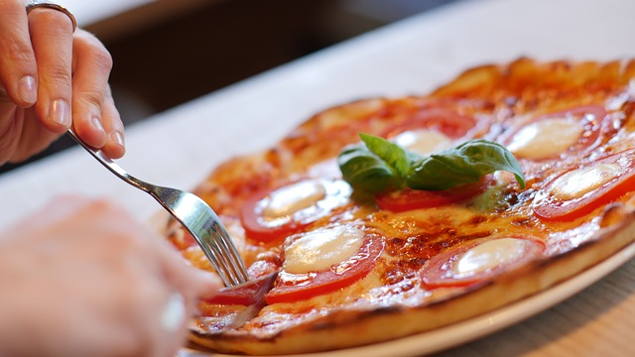
Greek Pizza?
A type of pizza, which consisted of a flatbread with various
toppings, was eaten by the ancient Greeks long before
the modern dish.

Slide 4
Integrated Pizza
India -- pickled ginger, minced mutton, and paneer (a form of cottage cheese)
Russia -- mockba (a combination of sardines, tuna, mackerel, salmon, and onions), red herring
Brazil -- green peas
Japan -- eel, squid, and Mayo Jaga (mayonnaise, potato, bacon)
France -- flambée (bacon, onion, fresh cream)
Pakistan – curry
Australia -- shrimp, pineapple, barbecue sauce
Costa Rica – coconut
Netherlands -- "Double Dutch" -- double meat, double cheese, double onion
United States -- pepperoni, mushrooms, sausage, green pepper, onion, and extra cheese

Slide 5
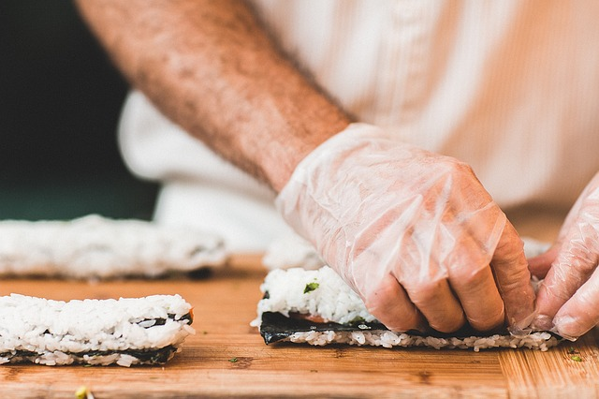
Sushi
There are more than 61,000
sushi restaurants
worldwide.
Originally, sushi was used as
a method of preserving fish.

Slide 6
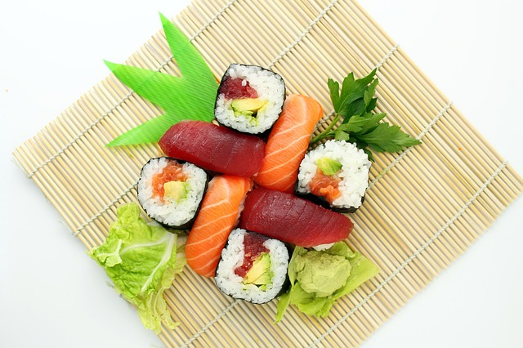
A Japanese Delicacy?
The Japanese developed sushi into the type of dish that is eaten
throughout the world today.

Slide 7
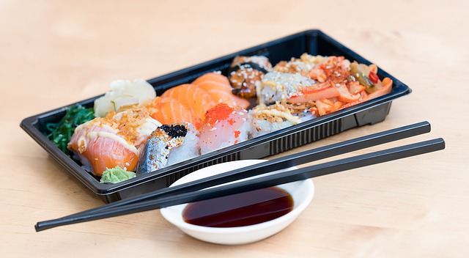
Japanese Fast Food

Slide 8
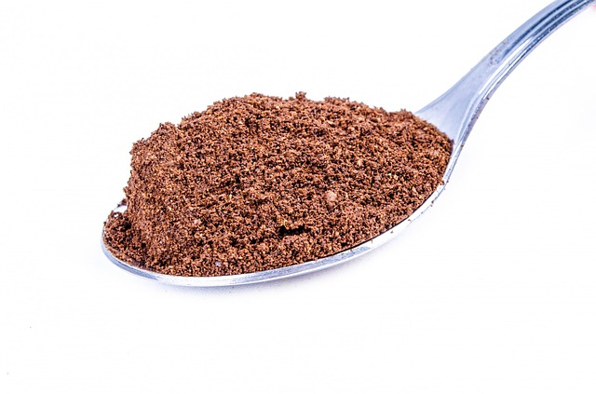
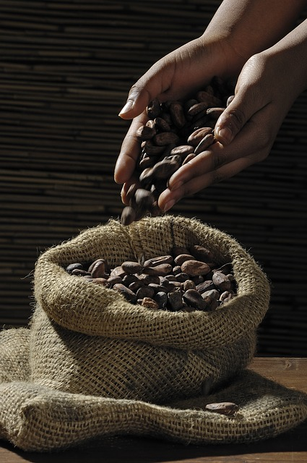
Chocolate

Slide 9
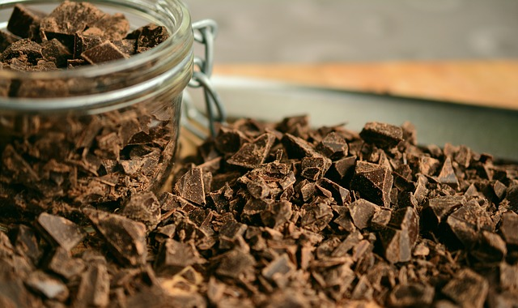
Chocolate

Slide 10
Chocolate can save your life!
Chocolate magnate Milton Hershey cancelled his reservation for the Titanic due to last minute business matters

Slide 11
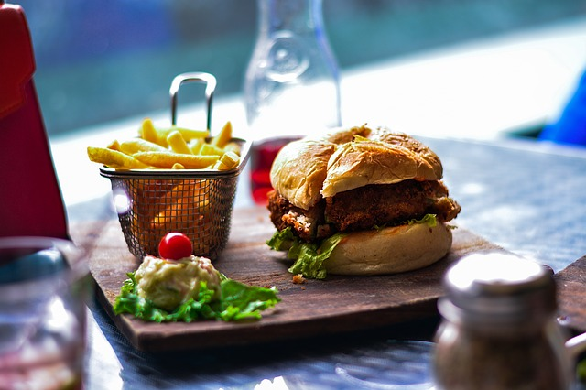
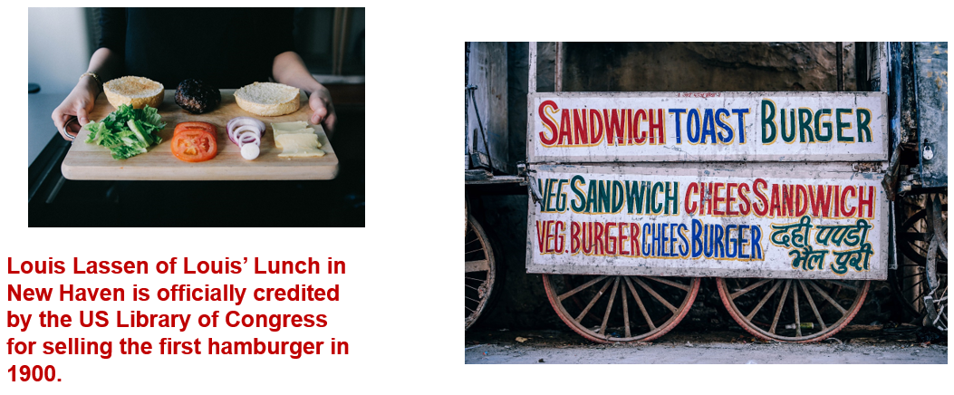
Burgers

Slide 12
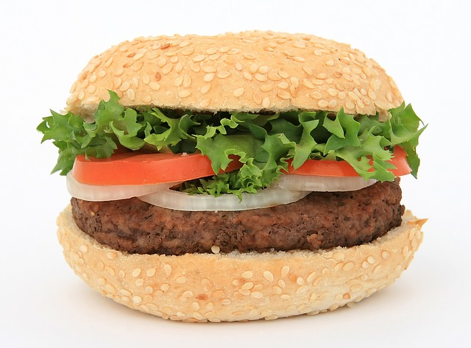
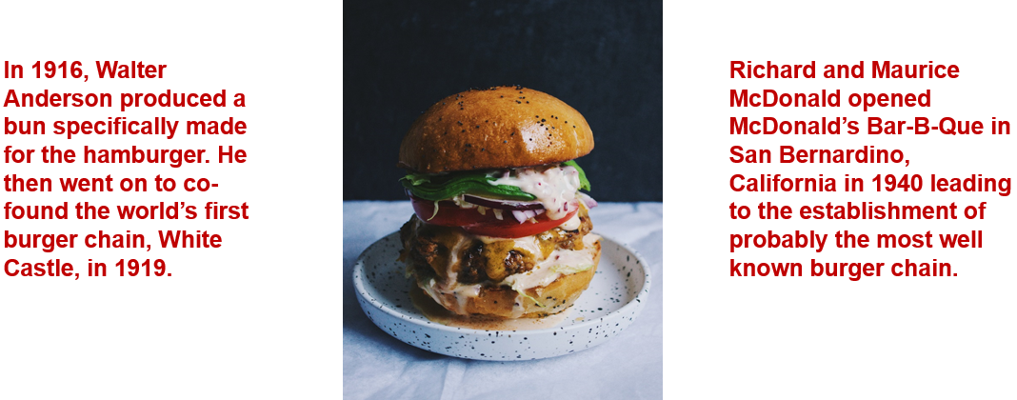
Burgers

Slide 13
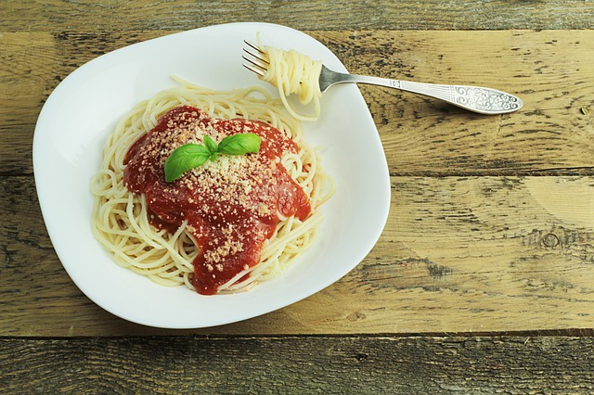
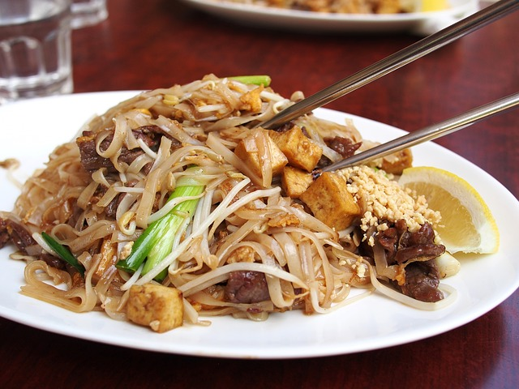
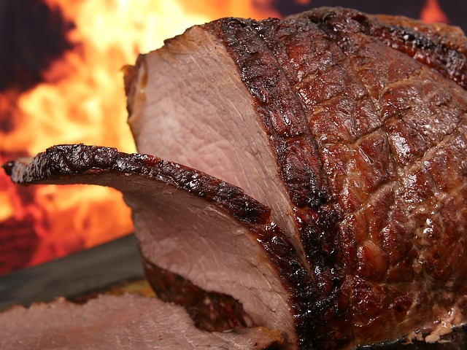
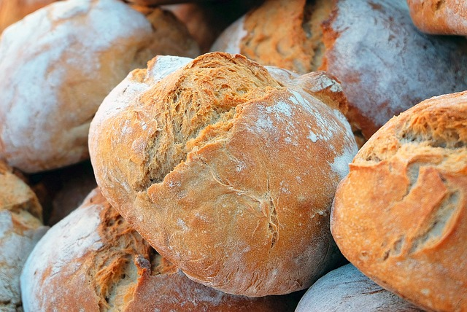
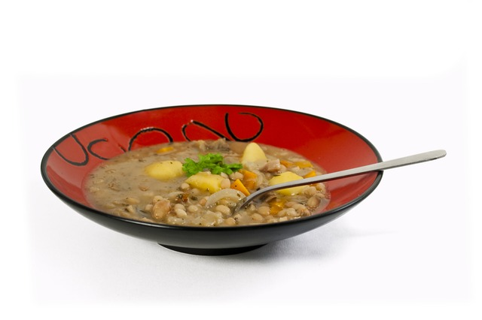
Foods of the World

Slide 14
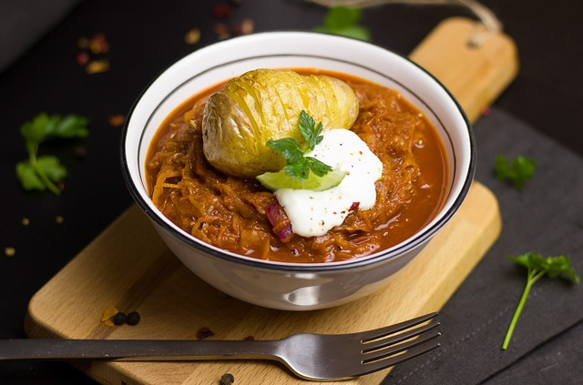
Exercise 1 – Local Menu
You can’t beat a good Irish Stew!

Slide 15
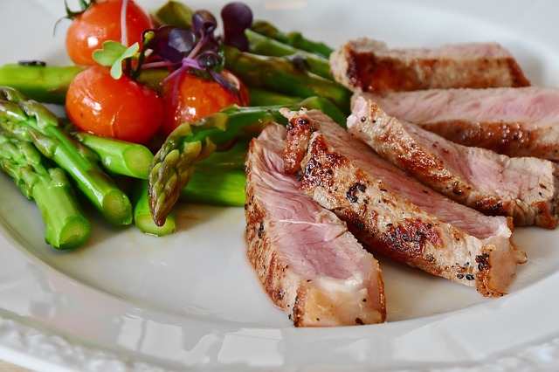
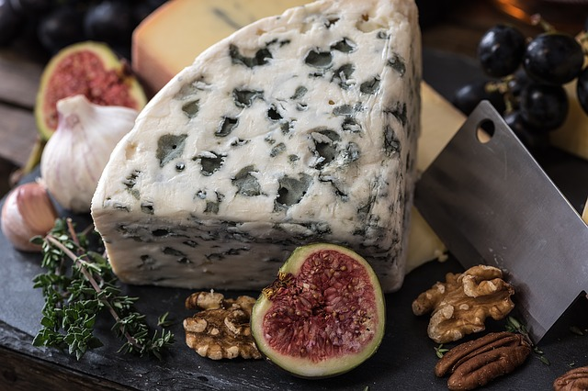
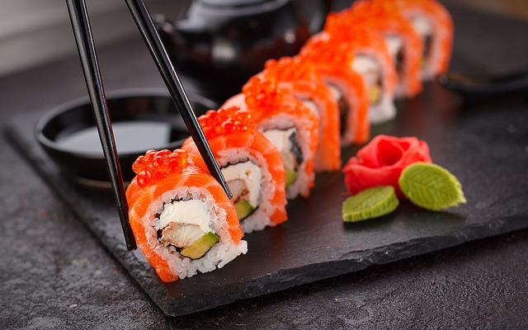
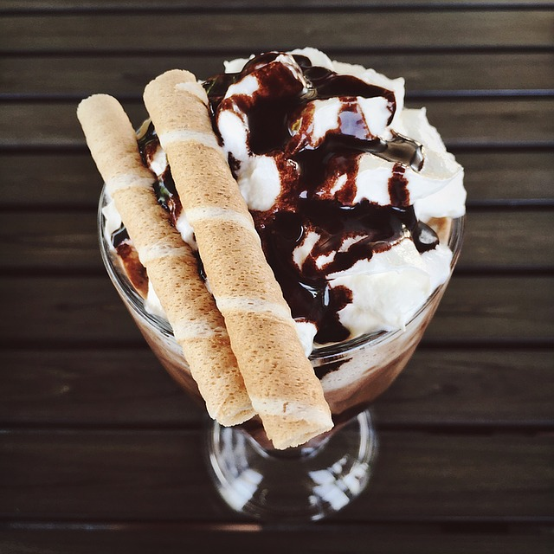
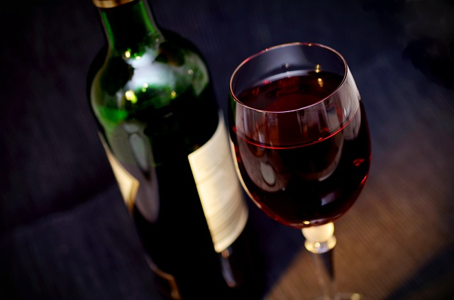
Exercise 2 – International Menu

Slide 16
Thanks!
All photographs courtesy of Pixabay.com
This project has been funded with support from the European Commission.
This document reflects the views only of the author and the Commission cannot be
held responsible for any use which might be made of the information contained herein.
Project Number: 2017-1-FR01-KA204-037126

