Slide 1
Get Informed

Slide 2
Media Overload

Slide 3
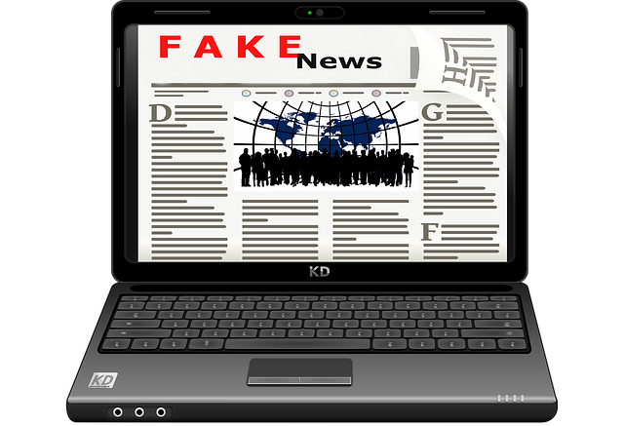
How can we identify what information is real?

Slide 4
Searching for answers

Slide 5
What’s the story?

Slide 6
Website analysis
Click on the website from where the information originated and check:
- Website mission
- Website name
- Contact details
- Website content
- Dates of posts

Slide 7
Website Name
Reputable Websites Unreliable Websites
http://therapistinabox.com
http://www.curezone.org
http://doctoryourself.com/
https://ec.europa.eu
http://www.mayoclinic.org
www.webmd.com
www.harvard.edu

Slide 8
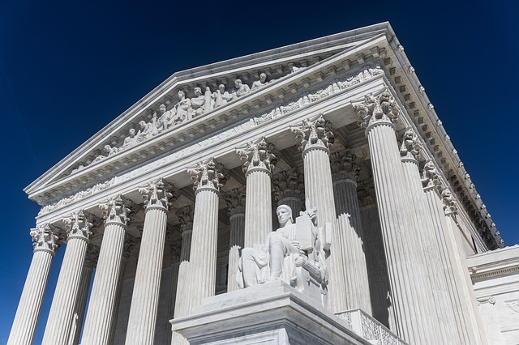
Academic and State sources

Slide 9
Agenda and Biases

Slide 10
Research the author
Is it a real person?
Are they respected and well known
in their specific field?

Slide 11
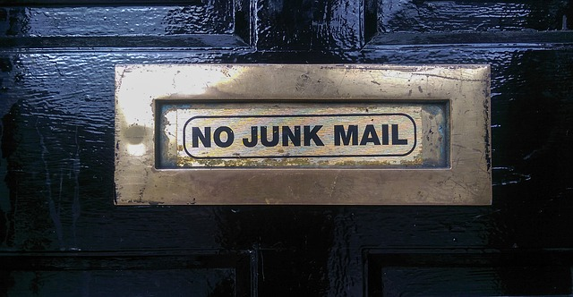
Sources to avoid
Emails from unknown sources
Parroting

Slide 12
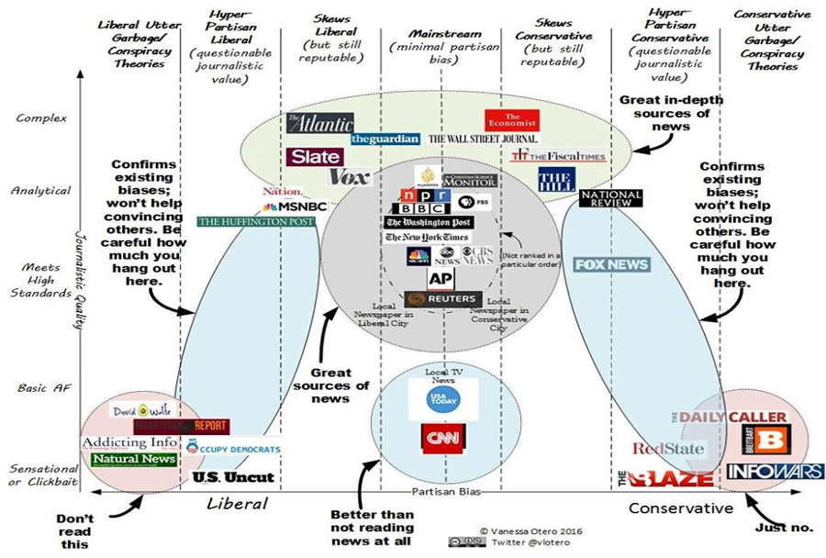
Activity – Reporting Biases

Slide 13
Thanks!
All photographs courtesy of Pixabay.com
This project has been funded with support from the European Commission.
This document reflects the views only of the author and the Commission cannot be
held responsible for any use which might be made of the information contained herein.
Project Number: 2017-1-FR01-KA204-037126

