Slide 1
Making Connections

Slide 2
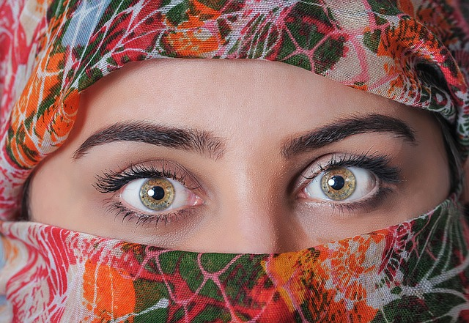
Culture Shock

Slide 3


Seeking Integration

Slide 4

Confused?

Slide 5
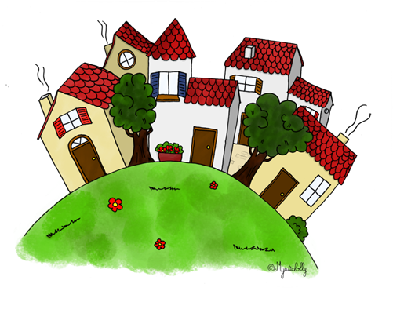
Model Village Approach

Slide 6
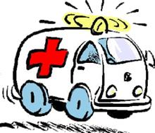
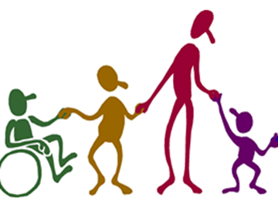



Key Services
Health Services + Education + Social Services + Public Authority + Law Enforcement

Slide 7

Key Supports
Place of Worship + Community Development + Sport & Recreation

Slide 8
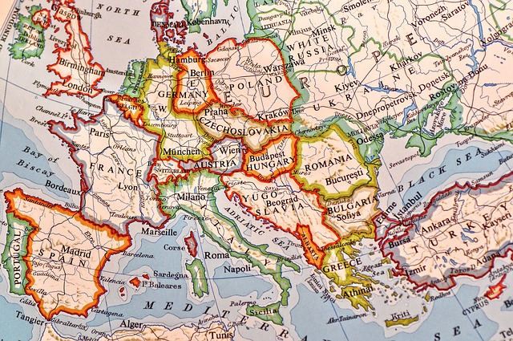
Your New Home

Slide 9

Sample Case Study
Anna
Lebanese
Female
29 years old
Married
1 Child aged 3
Trained as a nurse

Slide 10
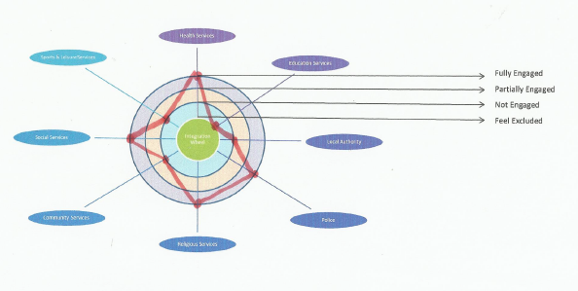
Anna’s Integration Wheel

Slide 11
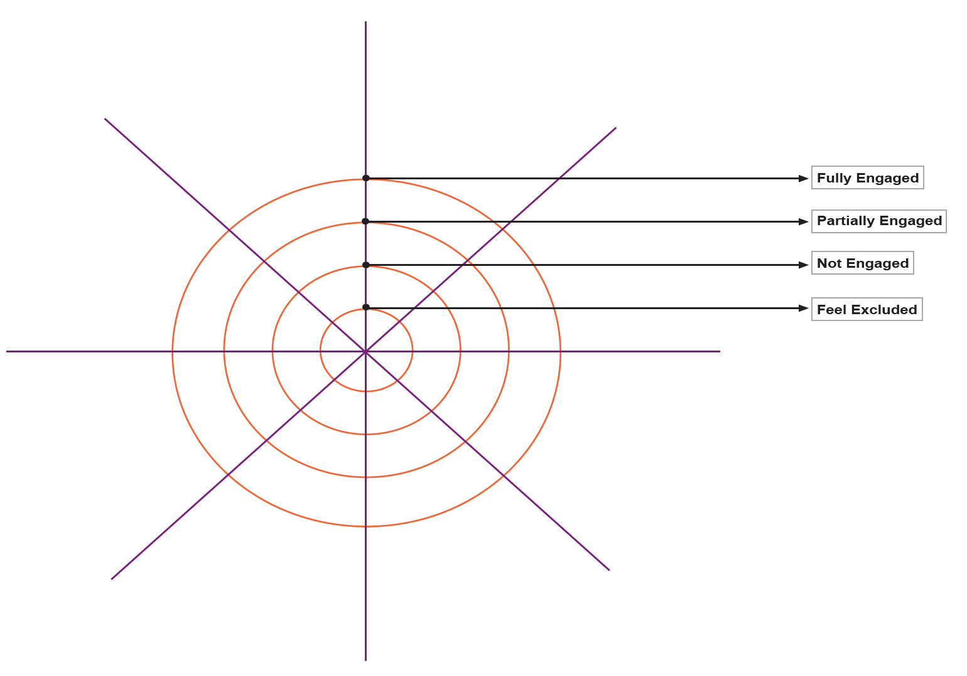
Personal Integration Wheel

Slide 12

Thanks!
All photographs courtesy of Pixabay.com
This project has been funded with support from the European Commission.
This document reflects the views only of the author and the Commission cannot be
held responsible for any use which might be made of the information contained herein.
Project Number: 2017-1-FR01-KA204-037126

