Slide 1
Peaceful Coexistence
Notes:
This resource outlines the principles and values of peaceful coexistence in Europe. It helps migrants to get to know their rights, entitlements and responsibilities in their new home country.
It provides a simple tool to reflect on the principles and values and to what extent they are personally accepting and adopting these principles and values in their daily life thinking, attitude and acting.

Slide 2
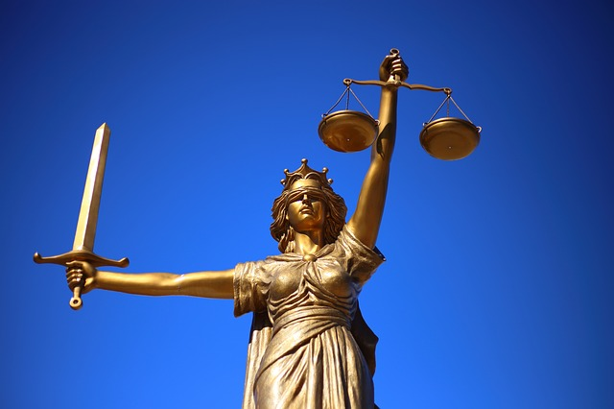
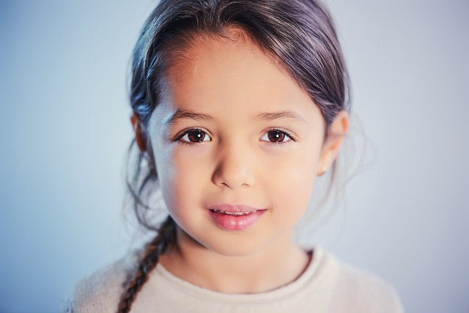
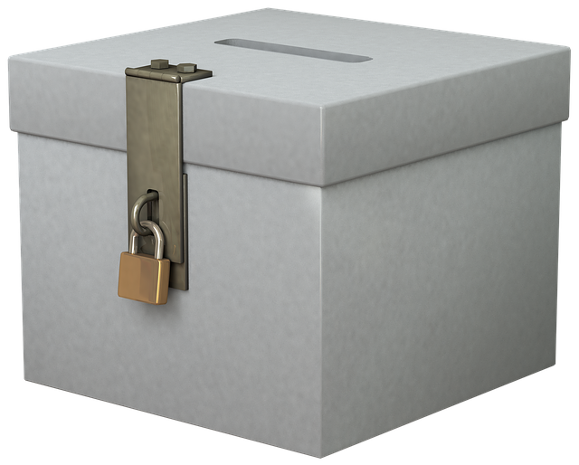
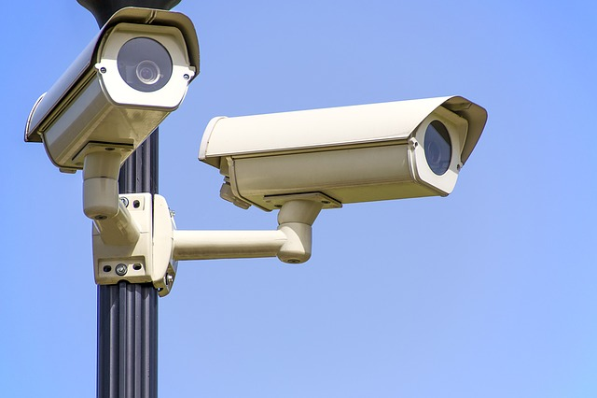
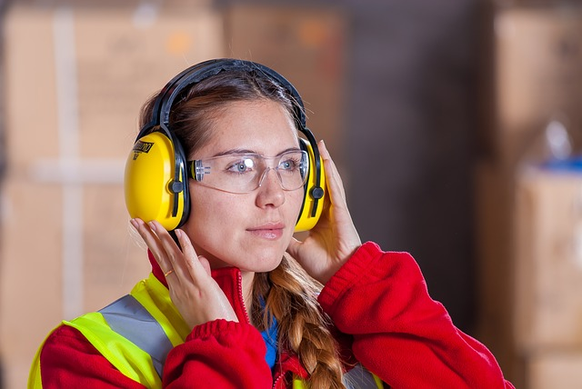
1 Basic Idea, 6 Principles, 18 Values
Rule of Law
Republic
Freedom
Human Dignity
Separation of Powers
Democracy
Federalism
Notes:
1 Basic Idea, 6 Principles, 18 Values.
You live now in a new country – together with millions of other people, a country where you can live in peace and play your part in ensuring our shared prosperity. Each of us is responsible for enabling all of us to live together in harmony. For despite many differences we build on the foundation of our shared values. They form the basis of coexistence in this country. Our constitution is also based on these values. We are all called upon to become aware of these values and live up to them in our daily lives. The following pages explain these principles and show you how and why they are important in your daily life. Knowing our values is important for you to become integrated in this country. After all, to become part of the society you first need to know what it is based on.

Slide 3
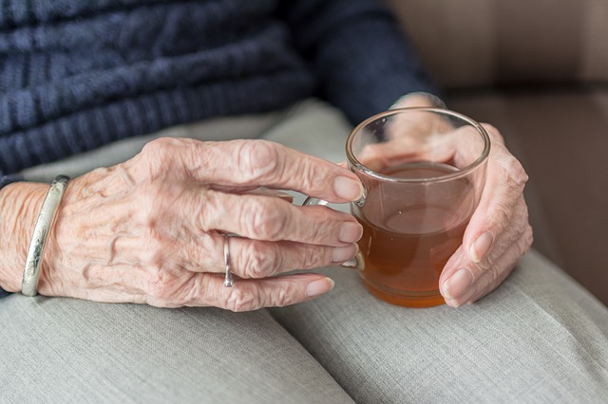
Our Core Value: Human Dignity
Everyone deserves respect, irrespective of gender,
age, education, religion, origin or appearance.
Notes:
Core Value: Human Dignity.
Everyone is equal in dignity. We have this human dignity right from the beginning of our life. It is not an attribute which some have and others don’t – it is the birth right of every human being. Everyone has different talents, strengths – and also weaknesses. But we all have the right to be treated with respect and dignity. This is why we should treat others with the same degree of respect and fairness as we would want to be treated ourselves.
Respect for human dignity underpins everything we do. Human dignity is inviolable. Human dignity does not depend on gender, age, education, religion, origin or appearance. Discrimination and racism have no place in Europe. Women and men have equal status. Their voice and their vote have equal value, above all in court proceedings and in democratic elections. Children also have rights and are specially protected. In our dealings with each other, respect for human dignity rules out any use of violence, particularly in the family. The equality of everyone before the law is the foundation of all decisions taken by judicial courts and authorities.

Slide 4
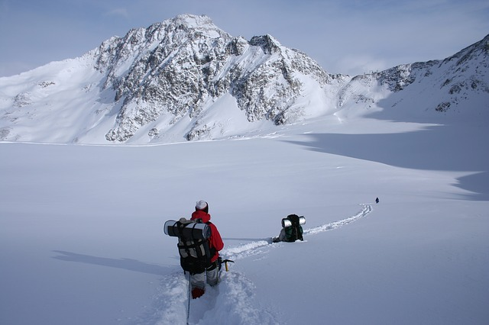
1st Principle: Freedom
My freedom ends where your freedom begins.
Values.
Self-determination: I take responsibility for my life.
Responsibility: I take responsibility for the lives of others.
Self-discipline: I respect orderly coexistence.
Notes:
1st Principle: Freedom.
Freedom can be the sort of feeling you get when you do outdoor sport – such as skiing in the mountains. But freedom also means that you take responsibility for exercising it, both for yourself and others, and obviously that you also recognise, value and respect this personal freedom of all other people. One expression of this is free speech: You’re free to have and express an opinion in public – just as your fellow human beings are free not to share your opinion.
Freedom requires responsibility and self-discipline. Everyone has the personal freedom to choose how they lead their lives. You are free to choose how you wish to act and behave within the limits of the law. You are also free to choose your lifestyle, your job or your religion. These are just a few examples of what personal freedom and self-determination can mean. At the same time, self-determination requires each individual to take on a lot of responsibility. First, this means taking personal responsibility for yourself, for choosing how best to care for your health or for deciding which educational opportunities you wish to use. Second, self-determination also means being responsible for others and for respecting the freedom of others. After all, they enjoy the same personal freedom as you do. This requires self-discipline on your part when you deal with your own needs and interests. It can also mean that you have to hold back at times so that others can enjoy their freedom. Naturally, individual freedom also has its limits. These are defined by law. The state safeguards civil rights and liberties by punishing those who violate these rights, but it must have good reason to intervene in matters of personal freedom. Such reasons are few and clearly defined.

Slide 5
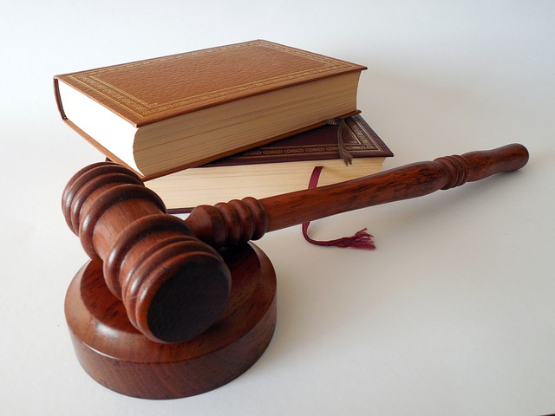
2nd Principle: Rule of Law
The same rules apply to me as they do to others and I recognize the achievements of others.
Values.
Justice: The same rules apply to me as they do to others.
Recognition: I recognise the rights of others.
Respect: I respect these rights by making them an integral part of everything I do.
Notes:
2nd Principle: Rule of Law.
Everyone is equal before the law. Everyone in this country must act in accordance with the law. Personal attitudes are not a reason for ignoring law: The law is applied equally to everyone. Everyone enjoys equal protection of their rights. Everyone is judged fairly, which means by the same rules, and exceptional personal circumstances are also taken into consideration. In the interests of the common good, everyone must respect and recognise the uniqueness of their fellow human beings. By achieving this on a personal level in your personal surroundings, you help justice prevail throughout society.

Slide 6
3rd Principle: Democracy
I actively get involved and express my opinion instead of looking on and judging from the side lines.
Values.
Participation: I am willing to play an active part in shaping co-existence.
(Cultural) education: I am interested and critical when acquiring the information and knowledge I need to have my say.
Openness: I am open to the new, the unfamiliar and to the participation of others.
Notes:
3rd Principle: Democracy.
The law emanates from the people. This is a democratic country. That means you have the right of co-determination. As a citizens you can become involved in the making of law and you cast your vote in elections. You can become involved in an interest group and in associations or participate in civic initiatives. Co-determination and participation does not only mean casting your vote in elections. Democracy is much more than that. It also means playing an active part in all areas of life which affect or interest you! In a democracy, your self-determination becomes co-determination. Like everyone else, you have the opportunity to come up with your own ideas. Democracy is based on participation. There is no democracy unless citizens express their opinions and play their part, together with others, to make and shape decisions and to take their share of responsibility for decisions that affect us all. This requires us to have a fundamental understanding of the country we live in – our (new) home. We can call this (cultural) education. Education in this sense does not mean that you have to be able to present some school or college leaving certificate. It means that you are called upon to be open, critical and curious when you explore backgrounds and contexts. The ability to point out problems and solutions requires you first to form an opinion – an opinion which is considered, open and impartial. An open mind is the key to gaining a deeper understanding of something. Learning to do this enables democracy to work.

Slide 7
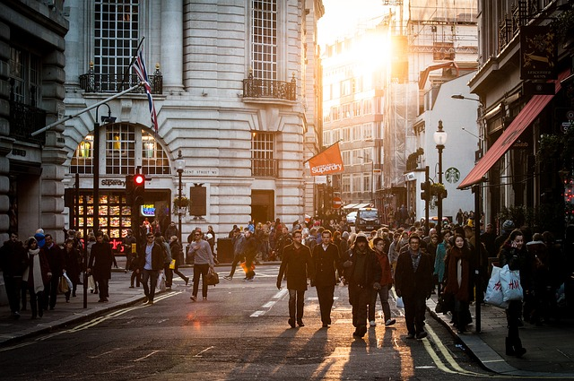
4th Principle: Republic
Working for the benefit of the community
ultimately means working for your own benefit.
Values.
Common good: Each contribution to the common good is important and valuable.
Willingness to act: Community also means that I act in solidarity with others.
Voluntariness: By volunteering, I enable peaceful co-existence through cohesion.
Notes:
4th Principle: Republic.
Coexistence requires cohesion. The state contributes to the common good to the extent that among other things it ensures security and peace and protects human and fundamental rights. Furthermore, it also provides for equal opportunities and social security. Laws and regulations passed in the interests of the common good are for the benefit of all citizens, even though they sometimes appear annoying at first glance. In this sense the public sector makes a decisive contribution to the education and health system. You also contribute by paying your taxes. That, too, is a form of solidarity. Cohesion and cooperation from the grassroots to the top of government define the essence of a republic. Everyone is called on to play their part in this respect. Basically, you are responsible for your livelihood. But if you can’t cope with an emergency or crisis situation by yourself, the community will offer you support. If you stand up for the rights of others and are prepared to act in solidarity then you will be contributing every day to the common good.

Slide 8
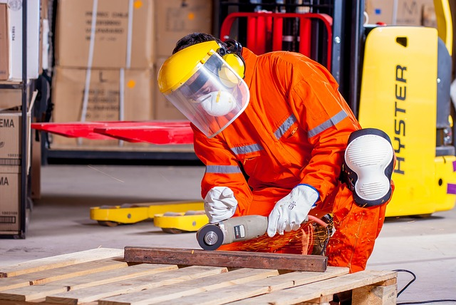
5th Principle: Federalism
Everyone has certain areas of responsibility
which one can best deal with by oneself.
Values.
Diversity: Everyone lives their own lives, true to traditions and cultures.
Personal responsibility: Wherever possible, everyone should be able to take care of themselves.
Achievement: I am willing to do my best and contribute actively to the common good.
Notes:
5th Principle: Federalism.
Everyone needs to play their part – the best solutions are often local solutions. The EU is a federal union consisting of federal states which again consist of federal provinces. The European and national authorities and the authorities of the federal provinces share the tasks of legislation and administration. In some cases they work together; in others they work on their own. Each unit has certain areas of responsibility which it can best deal with by itself. The division of tasks, duties and responsibilities into different units is called federalism. Federalism in Europe respects the particular characteristics and capabilities of the municipalities, federal provinces, states and the European Union. For example, the municipality establishes where people can obtain planning permission to build or develop a site because it is best placed to know where housing is required. Many different features have led to a unique form of diversity. They also form the basis for development, security and prosperity. Federalism is fuelled by the idea that all parts – including you, as the smallest individual part – try to do your job as best they can. Only when the smallest part is unable to solve a task by itself does the bigger part step in. This form of allocating responsibilities is called subsidiarity. It applies to nation’s relationship with the European Union.

Slide 9
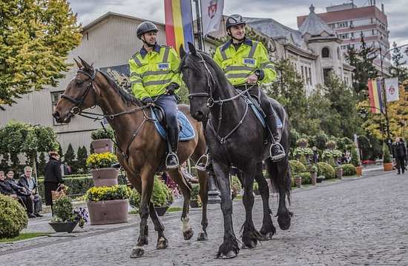
6th Principle: Separation of Powers
A society in which people’s rights are respected
is a safe and secure society.
Values.
Safety and security: By supporting the cause of public safety in our community, I also agree to respect and protect human dignity.
The culture of conflict: I try to resolve conflicts peacefully in the interests of respect and fairness.
Moral courage: I am willing to advocate a non-violent culture of conflict.
Notes:
6th Principle: Separation of Powers.
Imagine you hear loud noises and arguments in the apartment next to you. There is a conflict in the family. What are your options to help resolve this sort of situation in a suitable way? You can intervene personally, ask others for help or call the police. Whatever you decide to do, it takes courage to try and settle disputes rather than avoiding them out of fear. It takes moral courage to call the police. Safety and security means respecting the dignity of others and protecting others. The state ensures public safety. In this sense the police provide a service by securing your safety. The state also has a monopoly on the use of force; so the power of the state is subject to control. This is a basic condition for ensuring that power is not exercised arbitrarily or without due reason.
The three state powers are the legislative power (parliament), the executive power (the government, the president and all other authorities) and the judicial power (the judiciary). Checks and balances are an integral part of the system. They prevent decisions from being made on an arbitrary basis. The police are entrusted with the task of safeguarding public safety and security in the country. By themselves, the separation of powers and the police are not enough to guarantee adequate security. Security also needs people who are prepared to stand up for it. It requires a culture of conflict – you have to be prepared to address conflicts peacefully, not violently, to assert your individual rights the rights of others – even if you fear being at a disadvantage by doing so. That is moral courage in practice, not in theory. The willingness to stand up for oneself and others doesn’t just have a short-term effect. When we all do this, we live in a secure country.

Slide 10
Reflection
HUMAN DIGNITY
FREEDOM
self-determination
responsibility
self-discipline
RULE OF LAW
justice
recognition
respect
DEMOCRACY
participation
(cultural) education
openness
REPUBLIC
common good
willingness to act
voluntariness
FEDERALISM
diversity
personal responsibility
achievement
SEPARATION OF POWERS
security
culture of conflict
moral courage
Notes:
Reflection.
Think about what you have read and heard: to what extent have you adopted these principles and values in your thinking, attitudes and in your daily life? Mark on the line where you see yourself. Use the previous slides if needed.

Slide 11
Sources
Zusammenleben in Österreich. Werte, die uns verbinden: Federal Ministry for Europe, Integration and Foreign Affairs
Photos: https://pixabay.com/ (CC0 Creative Commons)

Slide 12
Thanks!
This project has been funded with support from the European Commission.
This document reflects the views only of the author and the Commission cannot be
held responsible for any use which might be made of the information contained herein.
Project Number: 2017-1-FR01-KA204-037126

