Slide 1
Volunteering & Community Development

Slide 2
Benefits of Volunteering
Knowledge of your
local area
Gain valuable work experience
Wellbeing
Make new friends
Share skills and develop competences
Notes:
In this lecture, you will be introduced to an approach to support you if you are interested in implementing an event in your community. With a structured approach, you will learn what it needs to bring people together to celebrate, exchange their experiences or help each other with certain issues communities have to face.

Slide 3
What are you passionate about?

Slide 4
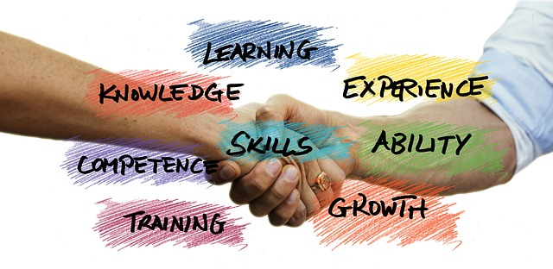
What skills do you have?

Slide 5
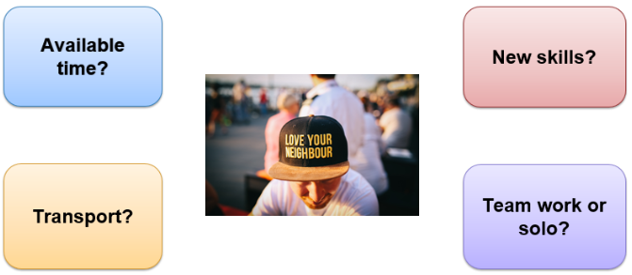
Other things to consider…

Slide 6
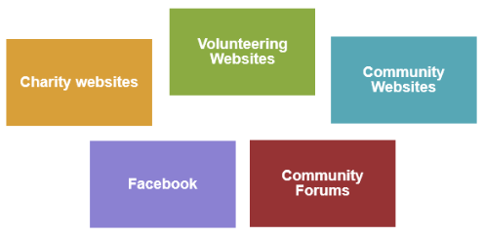
Online Resources

Slide 7
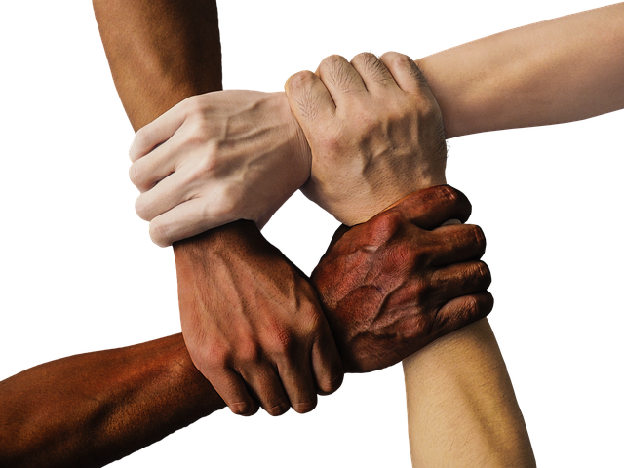
Community services

Slide 8
Local Library

Slide 9
Adult Education

Slide 10
Community Media

Slide 11
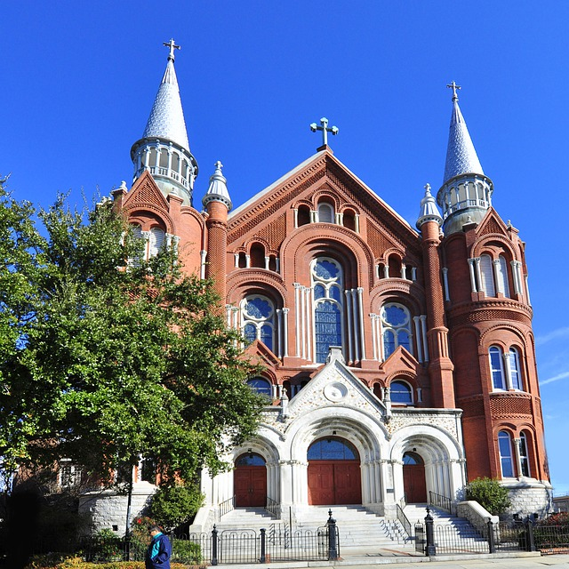
Community religious centres

Slide 12
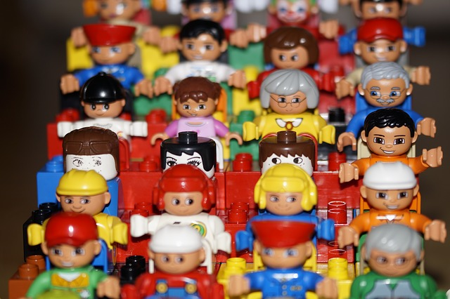
Benefits for everyone

Slide 13
Thanks!
All photographs courtesy of Pixabay.com
This project has been funded with support from the European Commission.
This document reflects the views only of the author and the Commission cannot be
held responsible for any use which might be made of the information contained herein.
Project Number: 2017-1-FR01-KA204-037126

